Slide 1




GHOST HUNTER'S CRYPT:
MASTERING ORDER AMID CHAOS
SHAINA JANA S. ALCANTARA
SHAMANTA JOY S. ALCANTARA
BSCS 2A

Slide 2

INTRODUCTION
In the heart of the haunted valley lies a crypt shrouded in mystery and legends of untold power. The Ghost Hunter, a fearless adventurer, has been summoned to tame the restless spirits and harness their energy to maintain balance in the spectral world. Each ghost harbors a unique power level, representing their strength and influence over the crypt's domain.
To succeed, the Ghost Hunter must learn to organize these spirits effectively, deciding which to summon, which to banish, and when to shift strategies to outwit the most cunning apparitions. However, the crypt operates under an ancient system of rules: a heap structure, where the strongest (or weakest) spirits must always rise to the top.

Slide 3

GHOST HUNTER’S OBJECTIVES
Master the Art of Heaps
Understand the fundamentals of max-heaps and min-heaps, and how they govern the order of spirits in the crypt.
Perform Key Heap Operations
Learn to summon spirits (insert) and banish them (delete) while maintaining the crypt’s order using heapify up and heapify down.
Adapt Strategies to Conquer the Crypt
Switch between max-heap and min-heap strategies to control the strongest or weakest spirits, depending on the challenge.
Solve Cryptic Challenges
Use problem-solving skills to find and defeat specific ghosts based on their power, even when faced with unexpected situations.

Slide 4
GHOST HUNTER’S OBJECTIVES
Visualize the Crypt’s Structure
See how the crypt’s hierarchy changes in real-time, understanding the impact of each action on the balance of power.
Handle Ghostly Inputs
Manage different forms of input, ensuring the program can handle both valid and invalid ghost power levels with ease.
Build Logical Programming Skills
Strengthen your logical thinking and decision-making by manipulating and organizing dynamic data in a haunted crypt.

Slide 5
MISSIONS
Summoning Spirits: Call forth (insert) the ghosts into the crypt and align them according to their power.
Banishing Spirits: Vanquish (delete) specific ghosts to weaken their hold on the crypt.
Adapting Strategies: Toggle between focusing on the strongest (Max Heap) and weakest (Min Heap) spirits, as some challenges require different approaches.
Reorganizing the Crypt: Every action causes the crypt to shift, and only a hunter who can maintain order will succeed.

Slide 6



GHOST HUNTER’S GUIDE
Begin by selecting a task from the Ghost Hunter's menu. Each option leads you on a different path in your hunt.
Choose Your Ghostly Quest

Slide 7
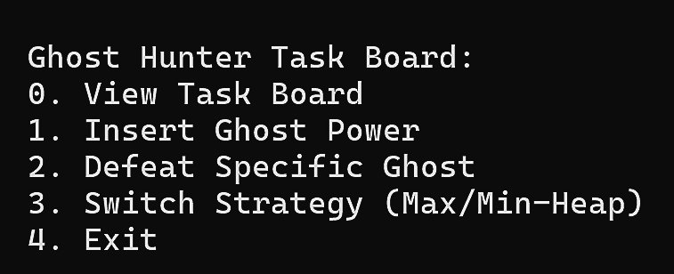
GHOST HUNTER’S GUIDE

Slide 8
COMPLETE THE TASKS ON THE BOARD
Add new ghosts to the crypt by specifying their power levels. Input multiple levels at once, separated by spaces.
Summon Spirits

Slide 9
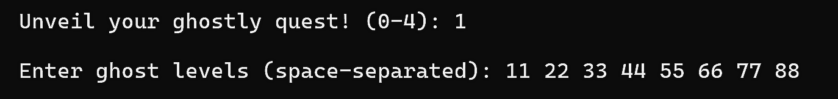
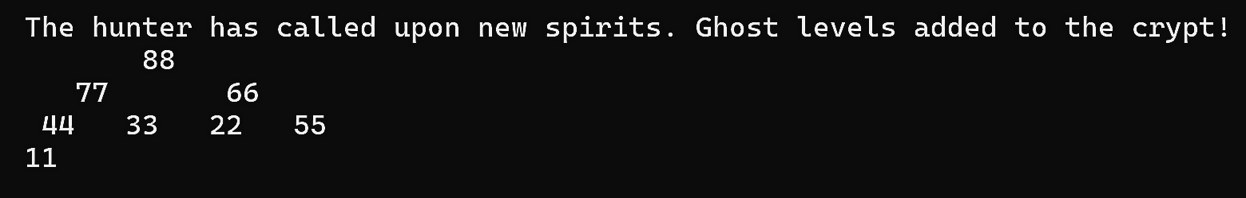
SUMMON SPIRITS
summon
manifestation

Slide 10

COMPLETE THE TASKS ON THE BOARD
Identify ghosts to banish by their power levels. The crypt will reorganize after each banishment.
Defeat Ghosts

Slide 11
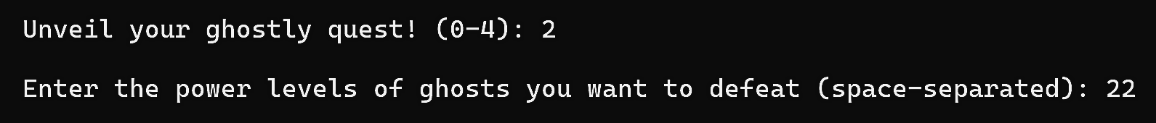
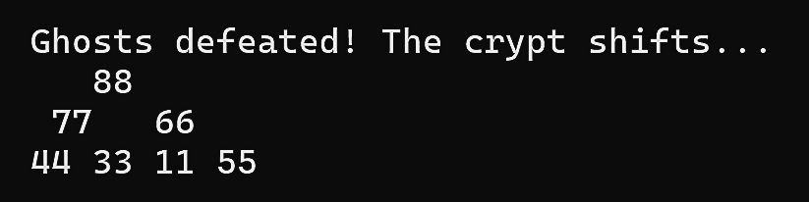
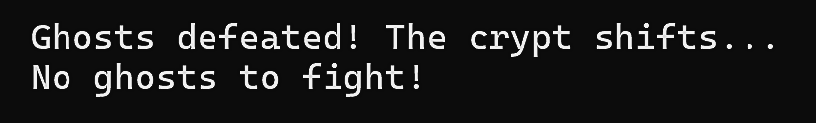
DEFEAT GHOSTS
lock your target
vanquish

Slide 12



COMPLETE THE TASKS ON THE BOARD
Switch Strategies
Change between max-heap and min-heap strategies to control the strongest or weakest ghosts. Observe how this affects the crypt’s structure.

Slide 13

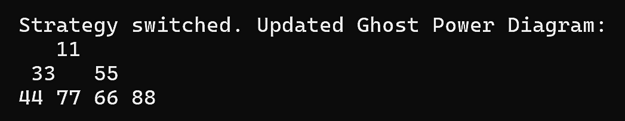
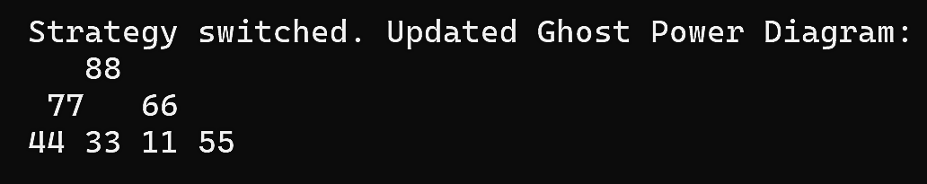
SWITCH STRATEGIES
MIN
mAX

Slide 14
HANDLE GHOSTLY INPUTS
Ensure that only valid ghost power levels are entered. If you try to summon ghosts with negative power or defeat ghosts not present, handle the error gracefully.

Slide 15
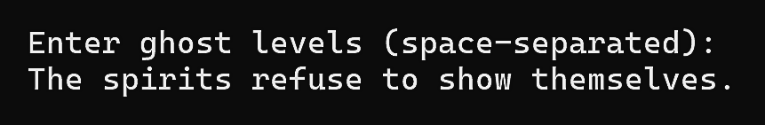
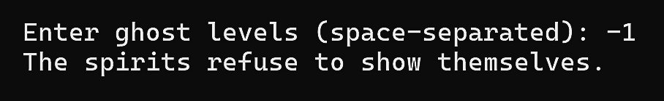
HANDLE GHOSTLY INPUTS
no input (task 1)
nEGATIVE input (task 1)

Slide 16
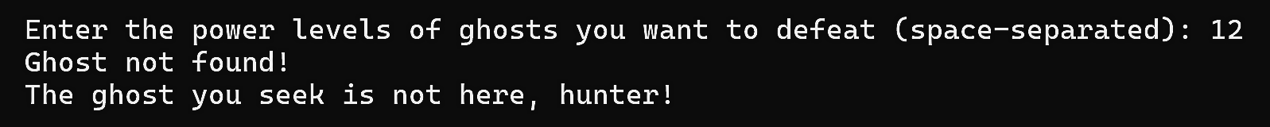
HANDLE GHOSTLY INPUTS
does not exist (task 2)
no input (task 2)

Slide 17
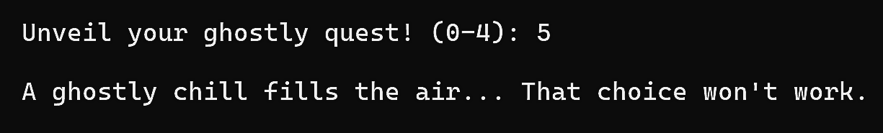
HANDLE GHOSTLY INPUTS
iNVALID CHOICE

Slide 18
EXIT THE CRYPT
Once all tasks are completed, exit the program with a final farewell message from the spirits.

Slide 19
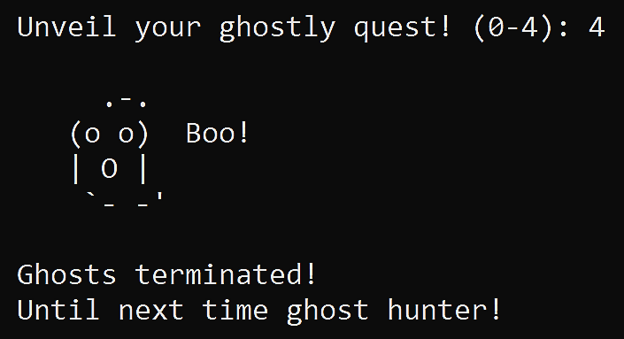
EXIT THE CRYPT

Slide 20
BOO!

